Slide 1
Computer Organization and Assembly Language
Lecture#3

Slide 2
Registers
A temporary storage places inside the processor called registers.
Registers are like a scratch pad ram inside the processor and their operation is very much like normal memory cells. They have precise locations and remember what is placed inside them. They are used when we need more than one data element inside the processor at one time.
Memory is a limited resource but the number of memory cells is large. Registers are relatively very small in number
Each register is 16 bit register.

Slide 3
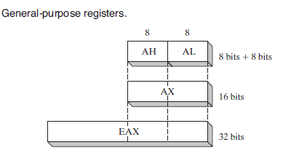
Cont.
We have 4 general purpose register in 8086.
AX (Accumulator Register)
BX (Base Register)
CX (Counter Register)
DX (Destination Register as it acts as the
destination in I/O operations)
Ref: reference book

Slide 4
Cont.
We have 2 Index register in 8086.
SI (Source Index)
DI (Destination Index)
We have 3 pointer register in 8086.
SP (Stack Pointer)
BP (Base Pointer)
IP (Instruction Pointer also called program counter holds the address of next instruction)
We have 4 Segment Registers in 8086
Code , Data, Stack, and Extra segments

Slide 5
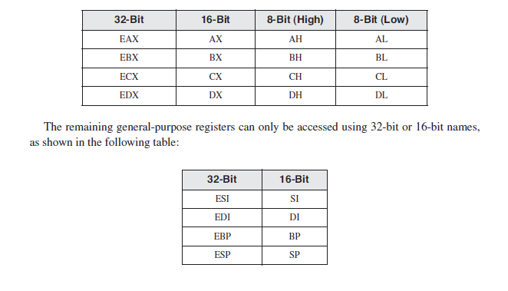
Cont.
Ref: reference book

Slide 6
Flag register
Status Flags The status flags reflect the outcomes of arithmetic and logical operations performed by the CPU.
The Carry flag (CF) is set when the result of an unsigned arithmetic operation is too large to fit into the destination.
The Overflow flag (OF) is set when the result of a signed arithmetic operation is too large or too small to fit into the destination.
The Sign flag (SF) is set when the result of an arithmetic or logical operation generates a negative result.
The Zero flag (ZF) is set when the result of an arithmetic or logical operation generates a result of zero.
The Auxiliary Carry flag (AC) is set when an arithmetic operation causes a carry from bit 3 to bit 4 in an 8-bit operand.
The Parity flag (PF) is set if the least-significant byte in the result contains an even number of 1 bits. Otherwise, PF is clear. In general, it is used for error checking when there is a possibility that data might be altered or corrupted.
Notes:
Carry Flag Sets when 2 things happes
a) two unsigned numbers were added and the result is larger than "capacity" of register where it is saved. Example: we wanna add two 8 bit numbers and save result in 8 bit register. In your example: 255 + 9 = 264 which is more that 8 bit register can store. So the value "8" will be saved there (264 & 255 = 8) and CF flag will be set.
b) two unsigned numbers were subtracted and we subtracted the bigger one from the smaller one. Example: 1-2 will give you 255 in result and CF flag will be set.
Overflow Flag is used as CF but when we work on signed numbers. Example we wanna add two 8 bit signed numbers: 127 + 2. the result is 129 but it is too much for 8bit signed number, so OF will be set. Similar when the result is too small like -128 - 1 = -129 which is out of scope for 8 bit signed numbers.

Slide 7
Cont.
Control Flags Control flags control the CPU’s operation. For example, they can cause the CPU to break after every instruction executes, interrupt when arithmetic overflow is detected, enter virtual-8086 mode, and enter protected mode.
Trap Flag
Direction Flag
Specifically related to string instructions, this flag tells whether the current operation has to be done from bottom to top of the block (D=0) or from top to bottom of the block (D=1).
Interrupt Flag

Slide 8
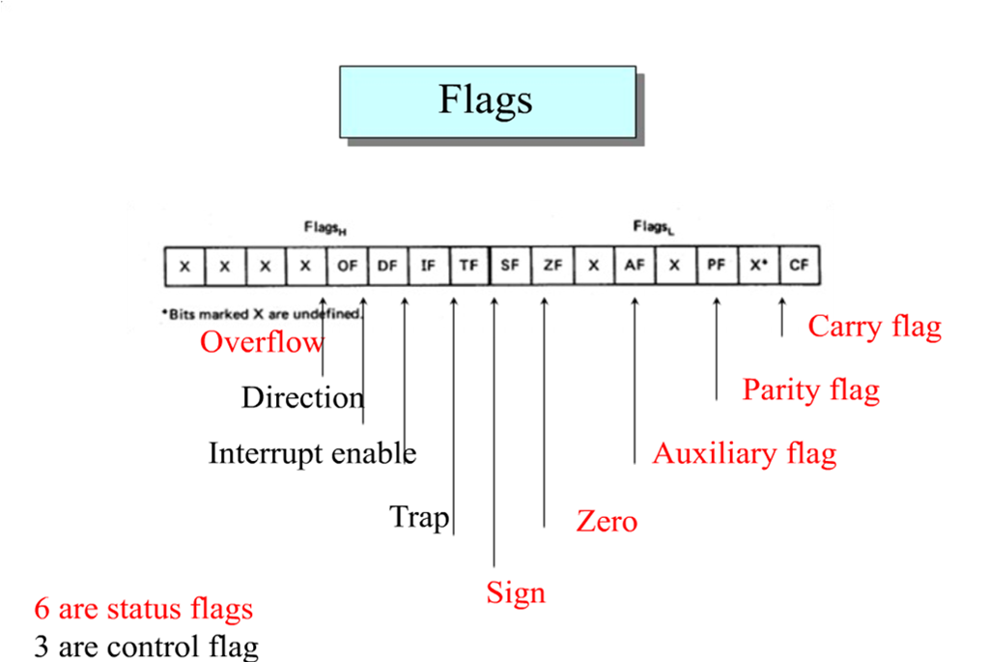
Cont.

Slide 9
Instruction Group
Data Movement Instructions
Mov
Arithmetic and Logic Instructions
Add , Sub, etc.
AND, OR, XOR, SHL, SHR , etc.
Program Control Instructions
Jmp (Jump)
call
Special Instructions
cli
sti
Where cli clears the interrupt flag and sti sets it.

Slide 10
First Assembly Program
English Version of Program
move 5 to ax
move 10 to bx
add bx to ax and save result in ax
move 15 to bx
add bx to ax and save result in ax

Slide 11
Basic Syntax of Assembly
operation destination, source
operation destination
operation source
operation

Slide 12
Assembly Version
;a program to add three numbers using registers
mov ax, 5 ; load first number in ax
mov bx, 10 ; load second number in bx
add ax, bx ; accumulate sum in ax
mov bx, 15 ; load third number in bx
add ax, bx ; accumulate sum in ax

